Slide 1

Project Prototype
Ashley, Adlina, Avryl, Lucas

Slide 2
Project Prototype
Consists of ??? Pages
Login page, homepage etc

Slide 3
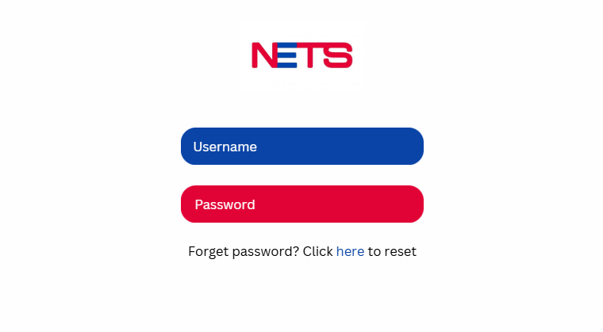
Login Page

Slide 4
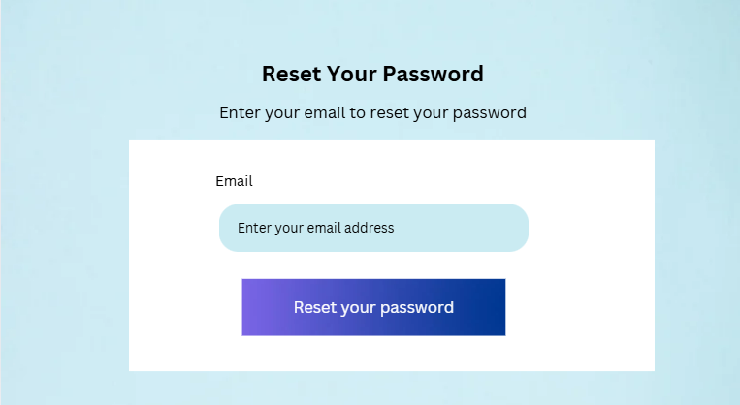
Forget Password Page

